Slide 1





Customer Shopping Behavior Analysis
An end-to-end data analytics project leveraging consumer shopping metrics to optimize marketing strategies, enhance customer engagement, and boost retention.
Sainath Pendem Analytics
Repo: Sainath-Pendem/Customer_Shopping_Behavior

Slide 2

Business Problem Statement
Key Analytical Focus
Identify Consumer Trends: Uncover high-value product categories and demographic purchasing behaviors.
Improve Engagement: Evaluate non-subscriber retention risks and subscription drivers.
Optimize Marketing Spend: Align promotional efforts with actual customer review ratings and revenue generation.
Slide 2 | Business Context
Customer Shopping Analysis

Slide 3




End-to-End Data Pipeline Workflow
1. Data Cleaning
2. SQL Modeling
3. Power BI
4. GitHub Repo
Python script handles null values, data transformation, and exploratory data analysis (EDA).
Structured database tables and executed aggregation queries for core metric calculations.
Designed an interactive dashboard with dynamic DAX measures for executive reporting.
Published documentation, data schema, SQL queries, and PBIX files for version control.
Slide 3 | Data Architecture
github.com/Sainath-Pendem/Customer_Shopping_Behavior

Slide 4



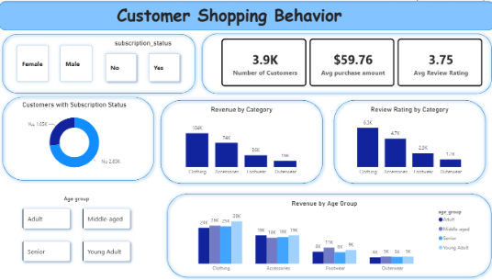

Executive Dashboard Overview
3.9K
$59.76
TOTAL CUSTOMERS
AVG PURCHASE AMOUNT
3.75 / 5
26.9%
AVG REVIEW RATING
SUBSCRIBER RATE
The Power BI dashboard provides a centralized view of customer demographics, subscription dynamics, and multi-category performance metrics.
Slide 4 | Power BI Reporting
Live Dashboard Metrics

Slide 5






Core Data Insights & Findings
73% Non-Subscribers
76% Revenue Dominance
Demographic Parity
Over 2,850 customers are currently non-subscribers. Converting a fraction of these repeat shoppers into subscribers represents the biggest opportunity for predictable revenue.
Clothing ($104K) and Accessories ($74K) generate over $178K in total sales, serving as the core acquisition channels across all shopper segments.
Purchasing power is remarkably balanced across Young Adults, Adults, Middle-aged, and Seniors. Marketing strategies should focus on product value over age segregation.
Slide 5 | Business Analytics
Key Findings

Slide 6
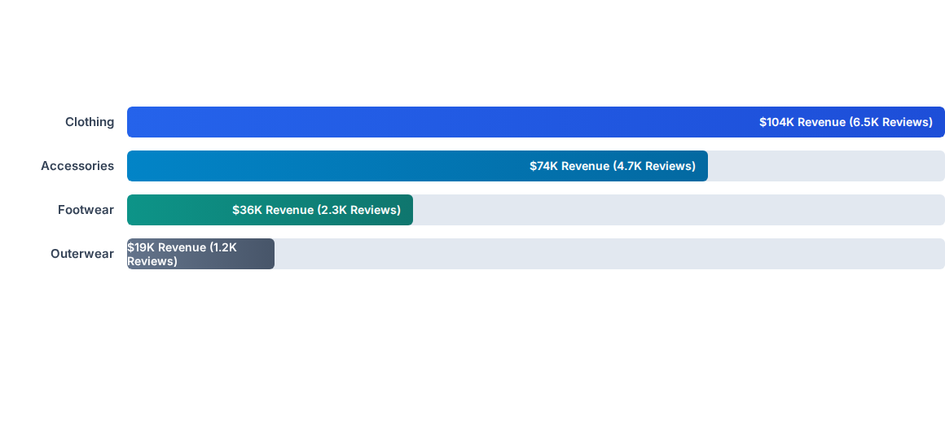
Revenue & Engagement by Category
Slide 6 | Performance Comparison
Product Analytics

Slide 7
Strategic Action Plan & Next Steps
Subscription Upsell Campaigns: Target the 2.85K non-subscribers with personalized post-purchase incentives (e.g., "Save 10% by starting a free trial").
Cross-Category Bundling: Pair top-selling Clothing items with complementary Accessories to drive the current $59.76 Average Purchase Amount higher.
Unified Ad Messaging: Maintain inclusive, feature-led advertising rather than strict demographic splits, leveraging the equal purchasing power across age tiers.
Project Access: Full source code, SQL queries, and Power BI report file are available at github.com/Sainath-Pendem/Customer_Shopping_Behavior.
Slide 7 | Recommendations
End of Presentation

